Slide 1


Overview of AI Technologies
Max Bezahler
Jan 21, 2020

Slide 2

Learning Objectives
At the end of this presentation you should be able to:
Provide an overview of AI
Setup Python environment and run Jupyter Notebooks
Use Pandas for high level data analysis
Understand and Run High level Concepts of
Sentiment Analysis
SVM
Knn
Know how to get help and run Python modules

Slide 3
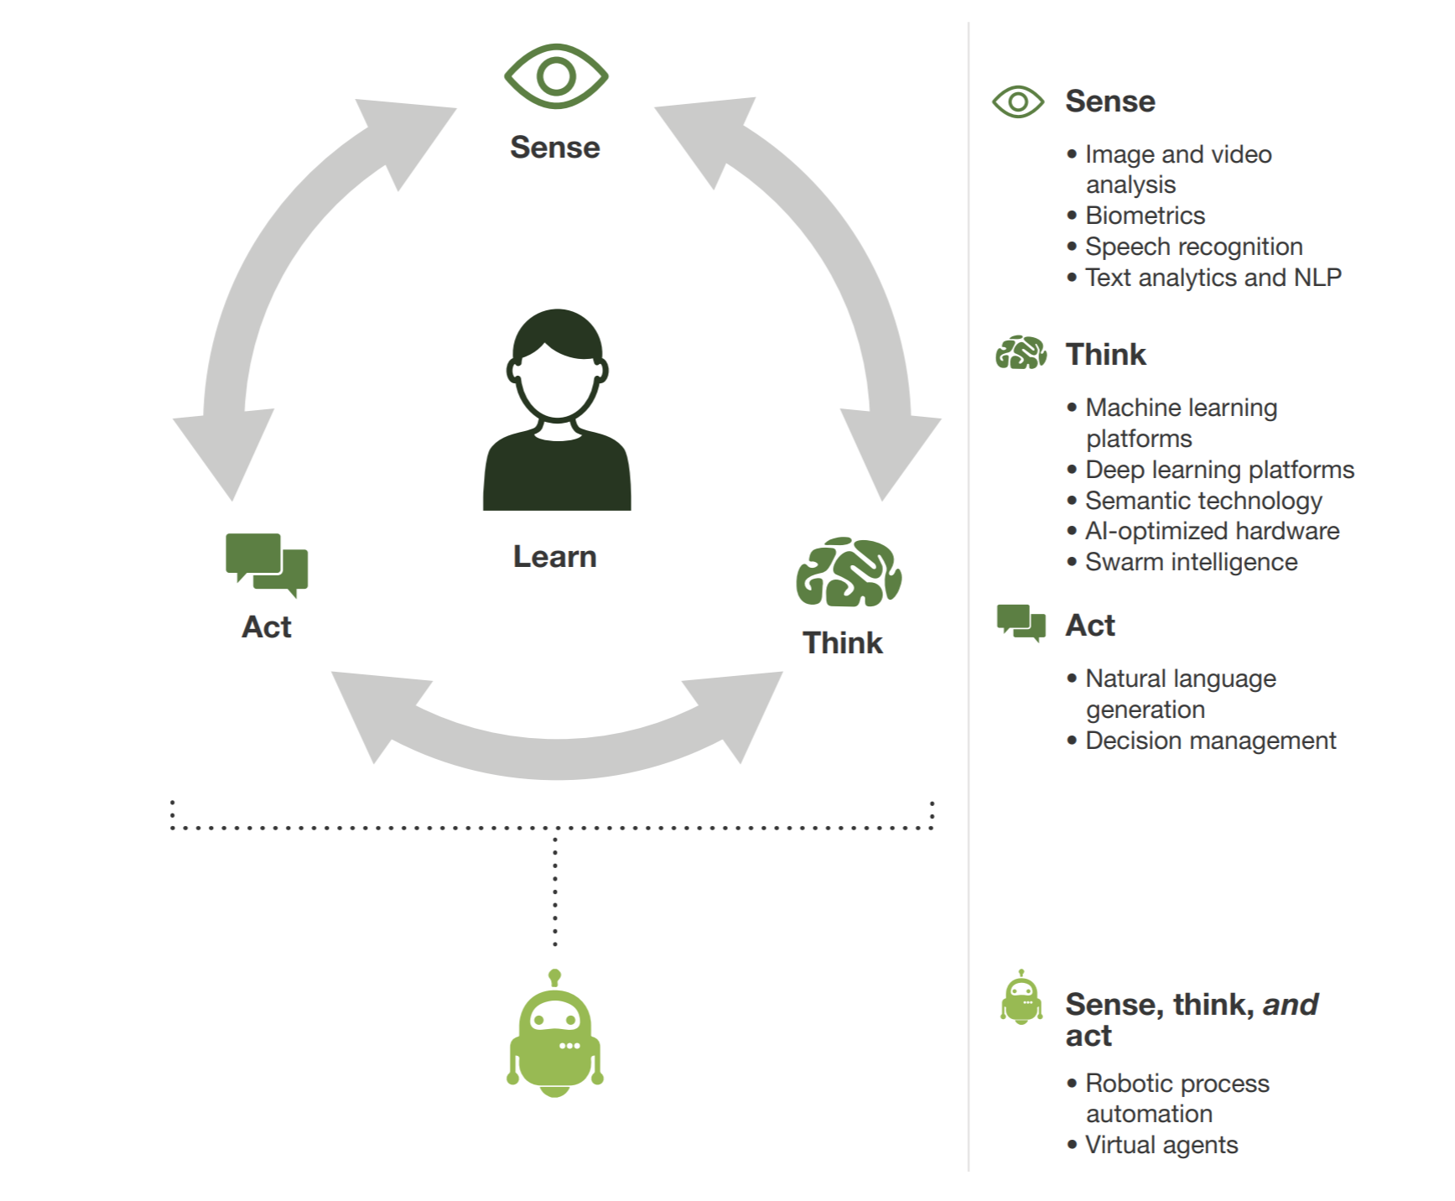

AI Technologies Mimic Humans’ Abilities To Sense, Think, And Act
https://en.wikipedia.org/wiki/Lethal_autonomous_weapon
https://www.youtube.com/user/BostonDynamics/videos

Slide 4

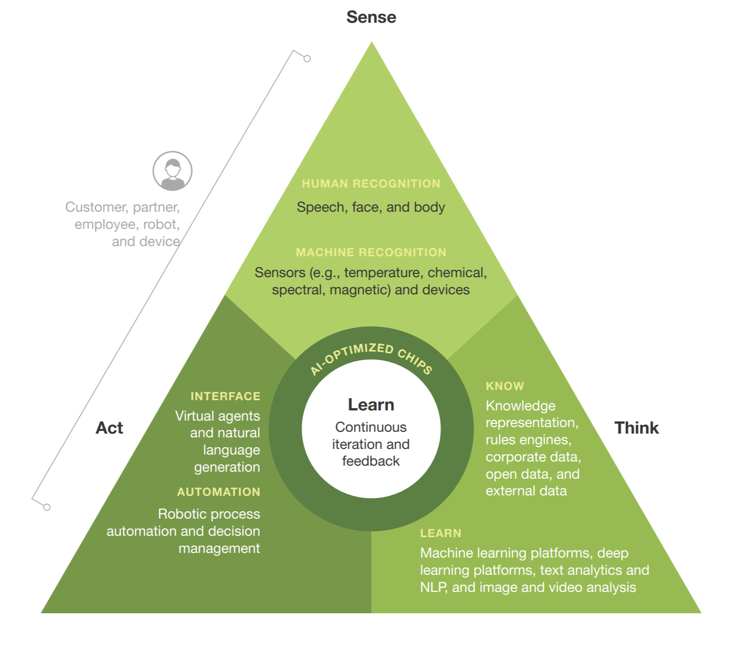
Connecting AI Components

Slide 5
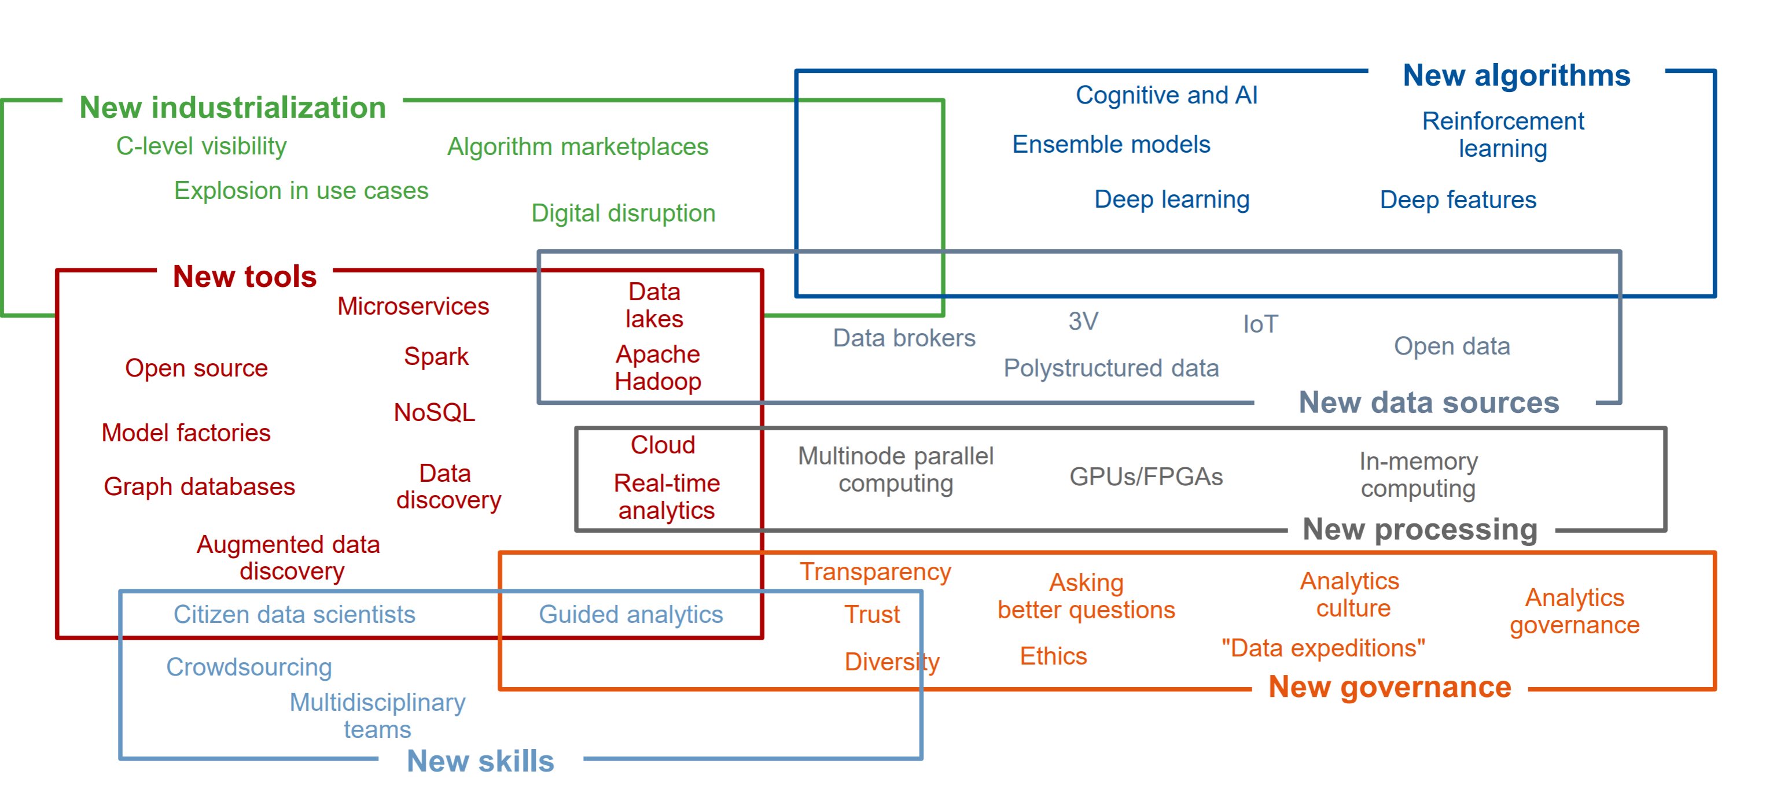
Domain Interactions

Slide 6
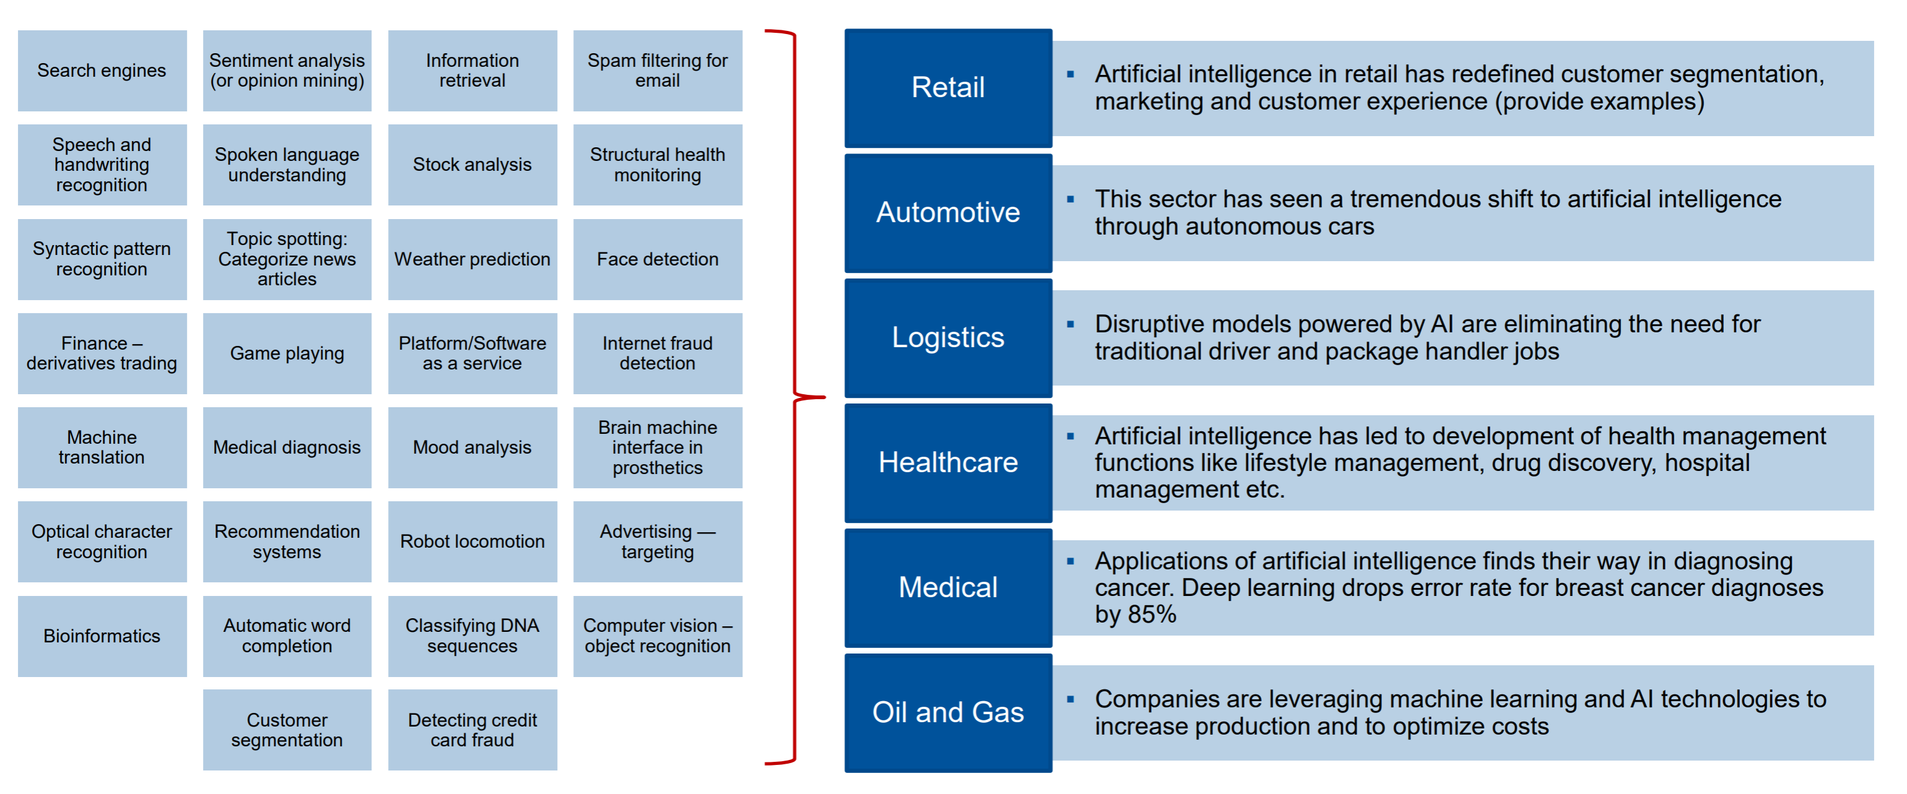
Industries

Slide 7
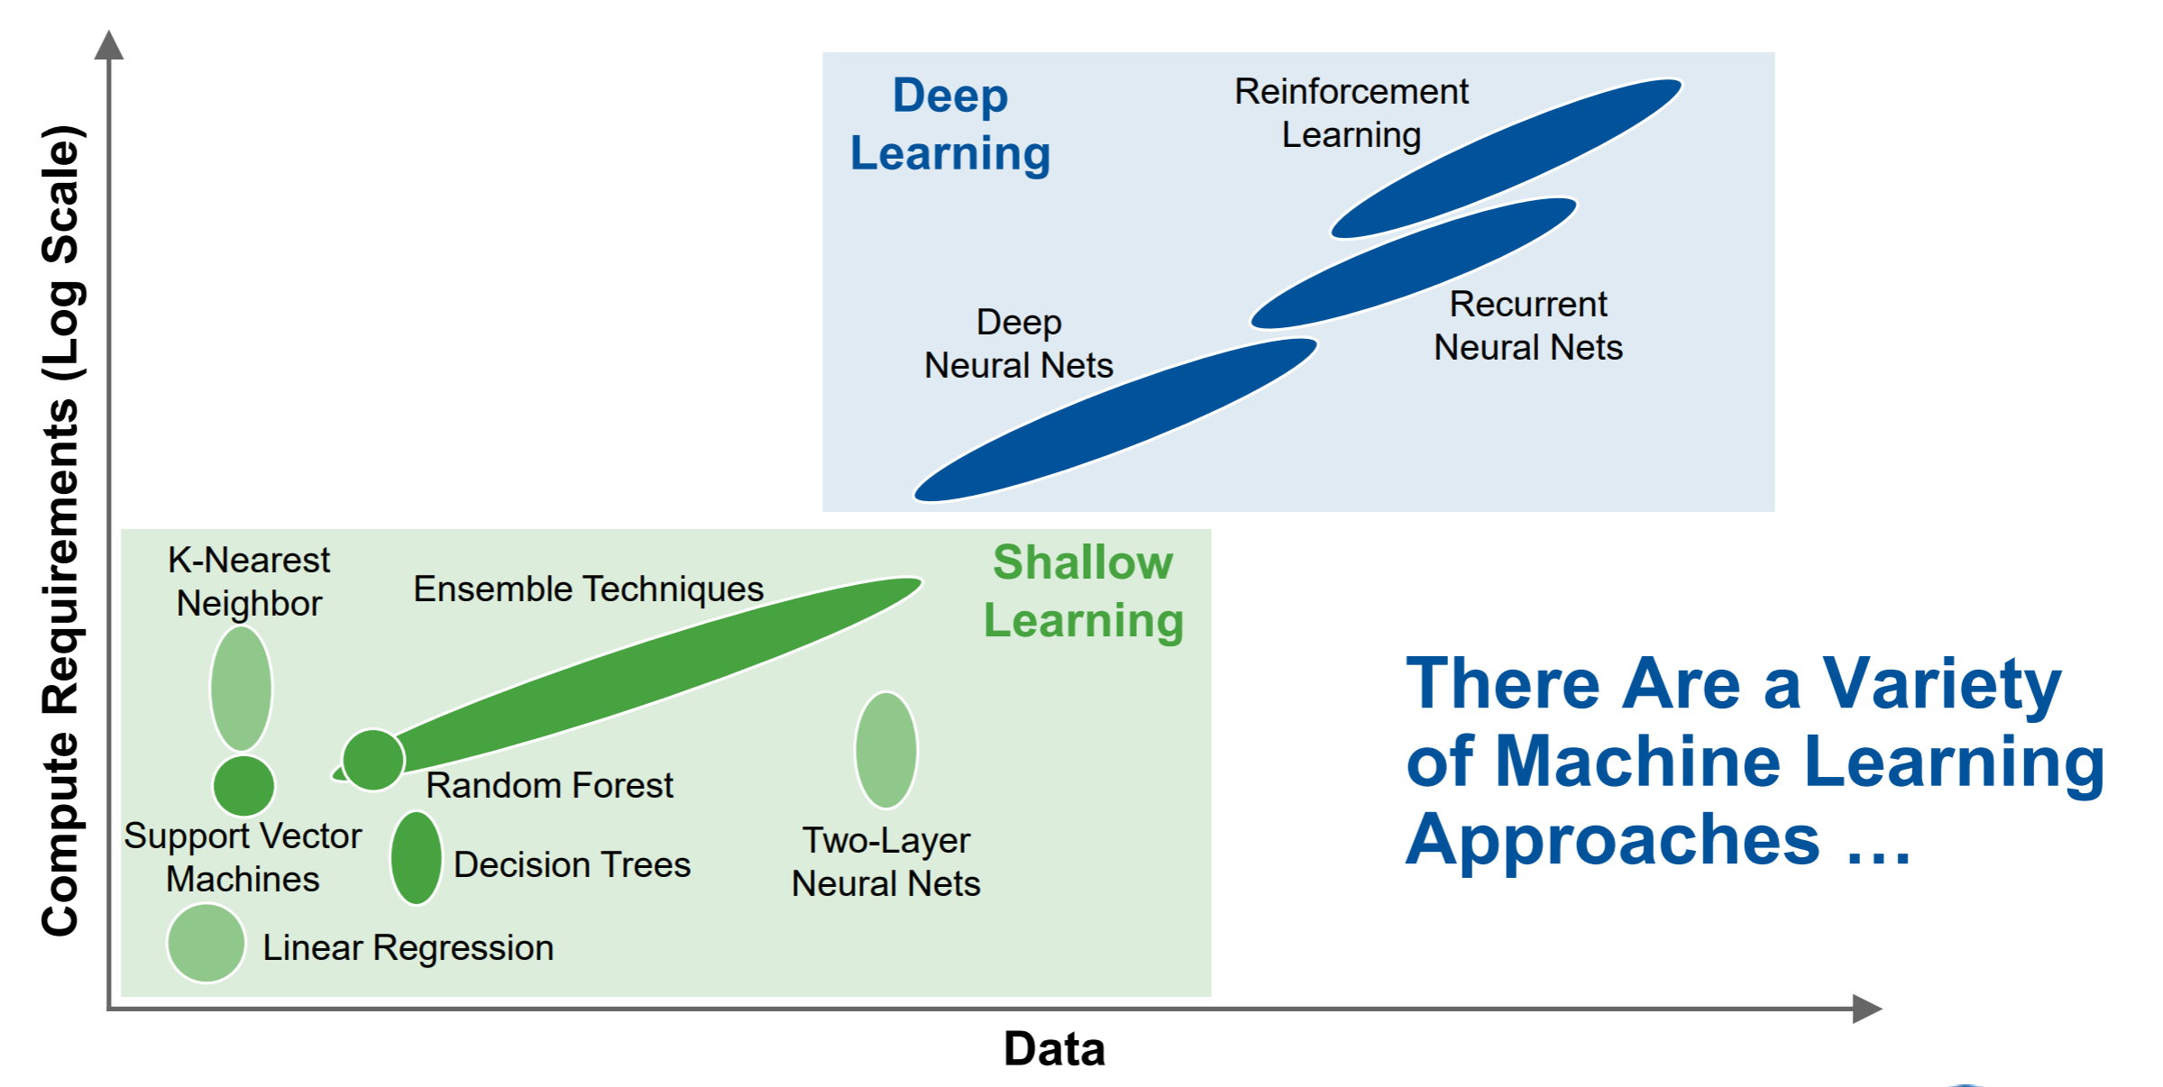
Gartner

Slide 8
Topics Covered Today
Topics and hands-on are covered in the specific Jupyter Notebook
Python Environment
Pandas
NLP Sentiment analysis
K Nearest Neighbors
Support Vector Machines

Slide 9
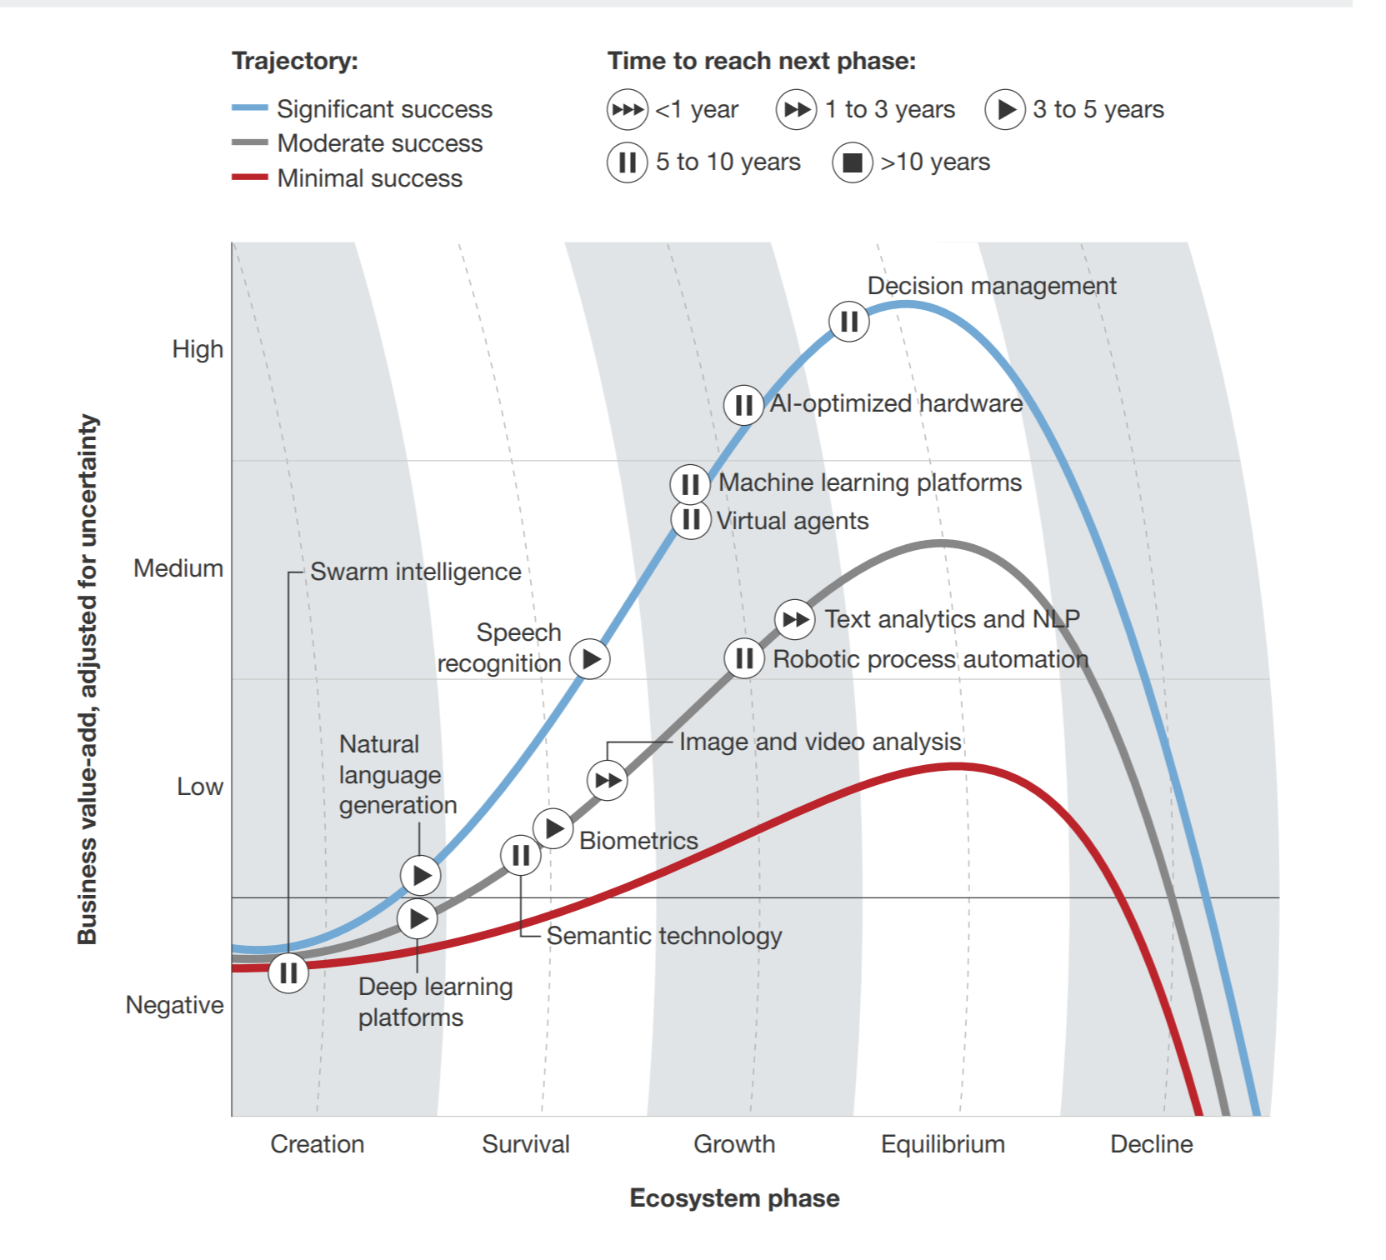
AI Readiness

Slide 10
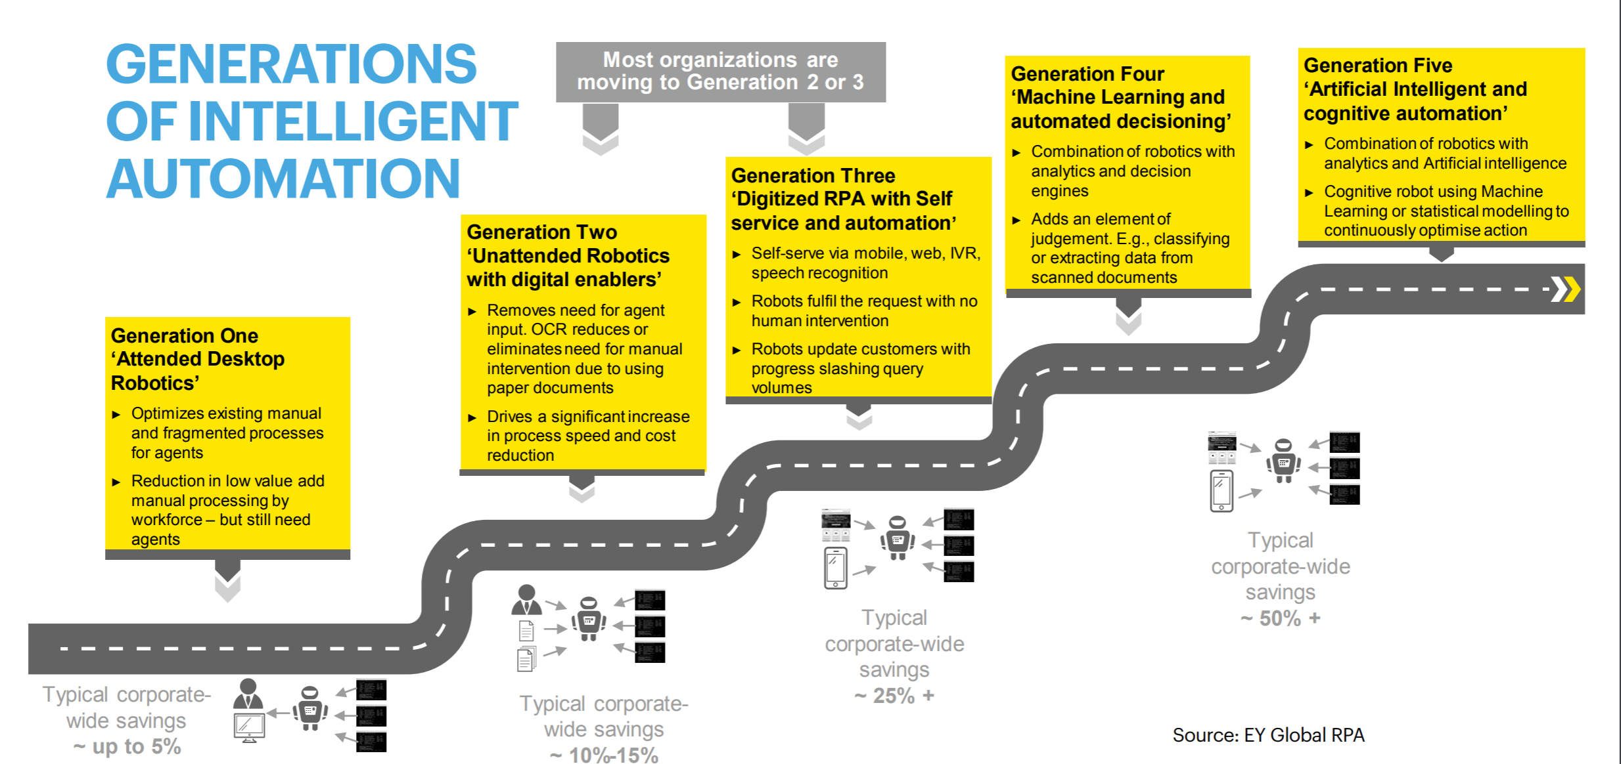
Robotic Process Automation

Slide 11
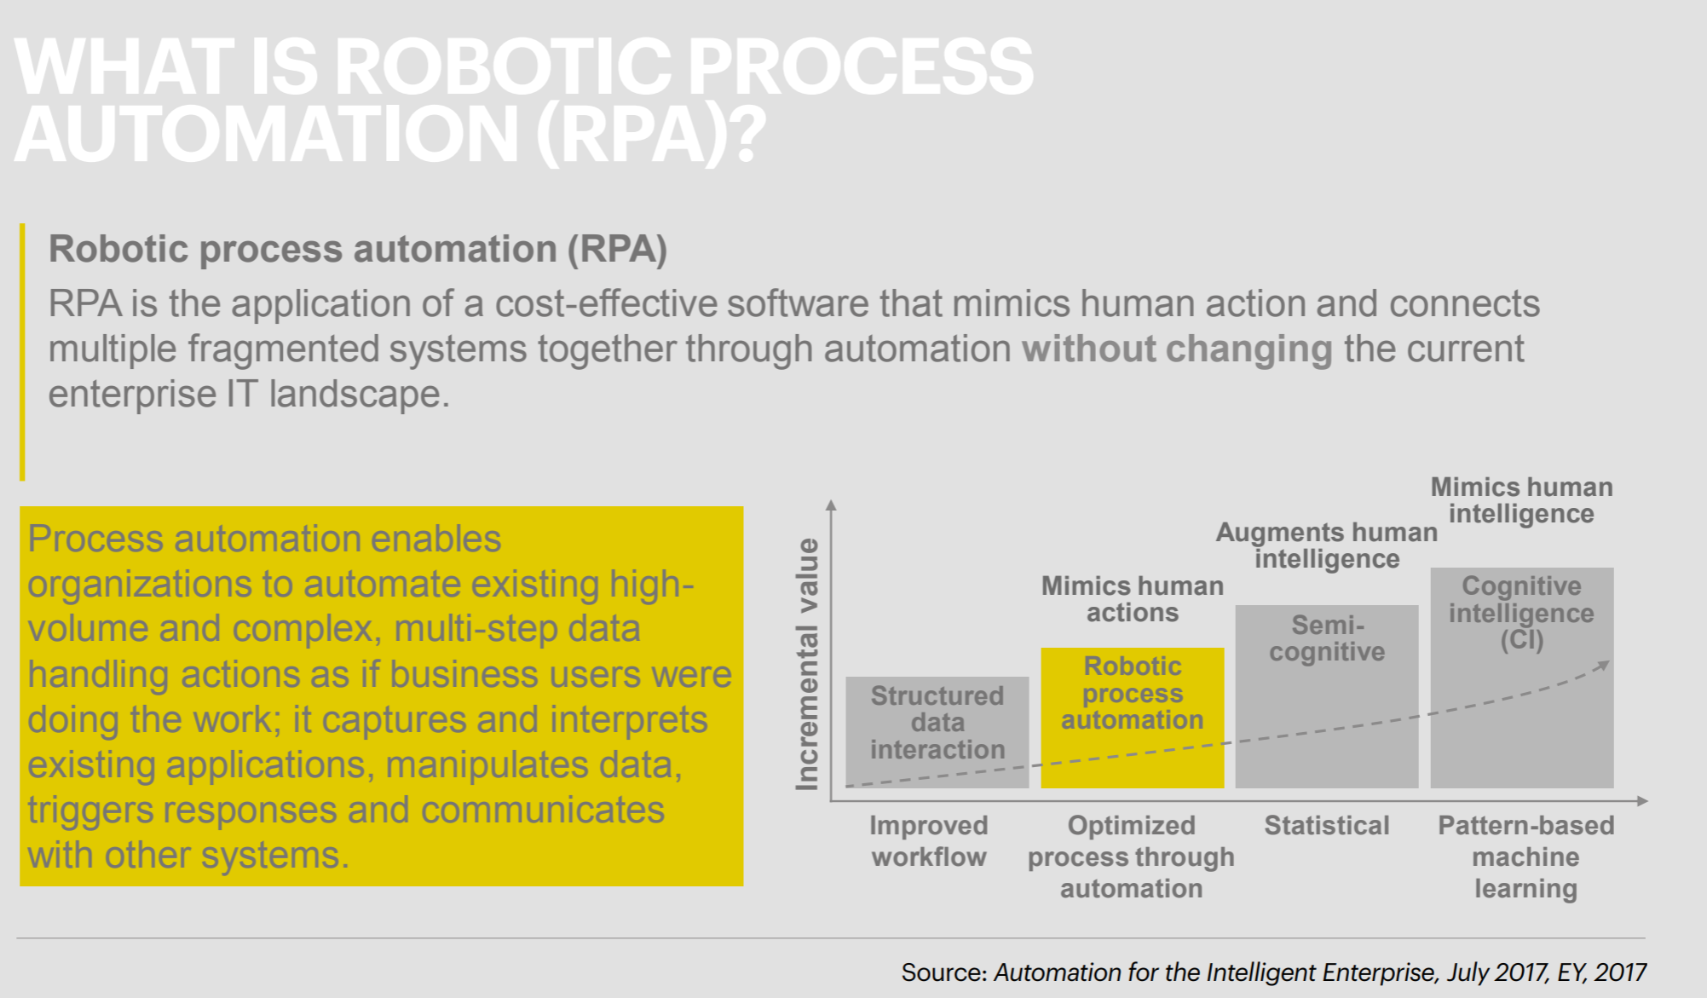
RPA

Slide 12
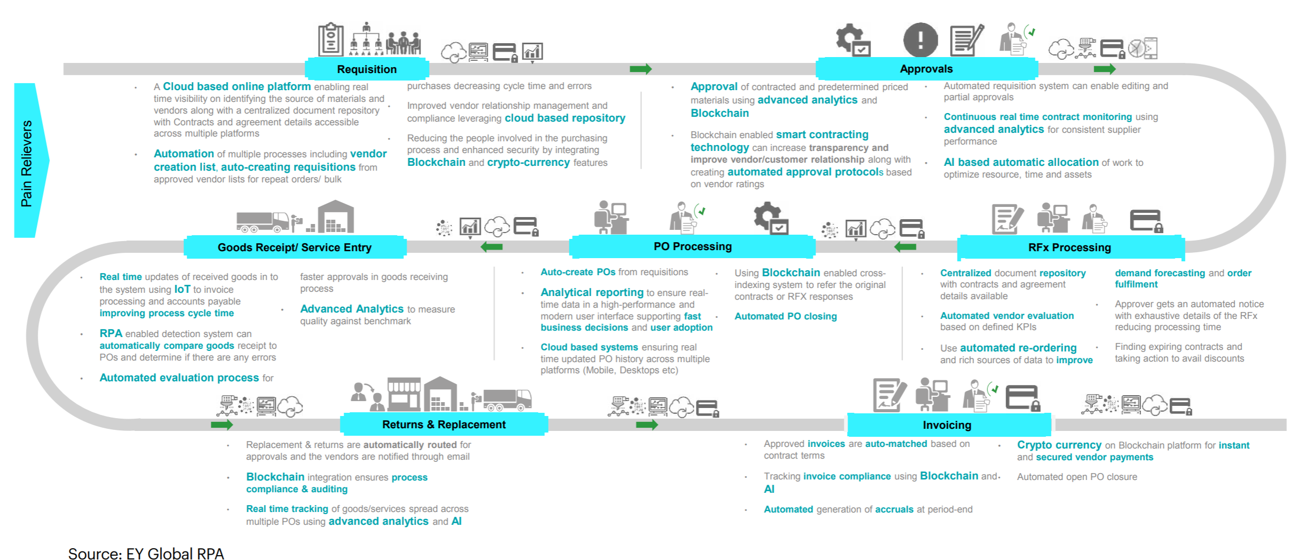
Why AI Matters – Business

Slide 13
Pandas
Key Features of Pandas
Fast and efficient DataFrame object with default and customized indexing.
Tools for loading data into in-memory data objects from different file formats.
Data alignment and integrated handling of missing data.
Reshaping and pivoting of date sets.
Label-based slicing, indexing and subsetting of large data sets.
Columns from a data structure can be deleted or inserted.
Group by data for aggregation and transformations.
High performance merging and joining of data.
Time Series functionality.
https://www.tutorialspoint.com/python_pandas/python_pandas_introduction.htm

Slide 14
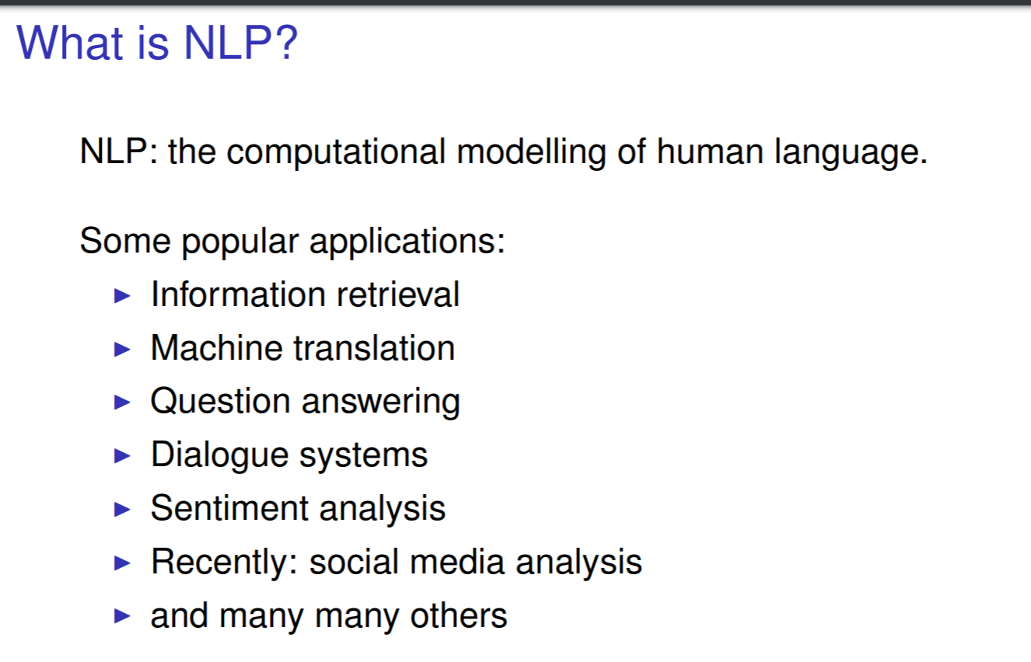
NLP
https://www.cl.cam.ac.uk/teaching/1617/NLP/slides1-public.pdf
https://web.stanford.edu/~jurafsky/NLPCourseraSlides.html

Slide 15
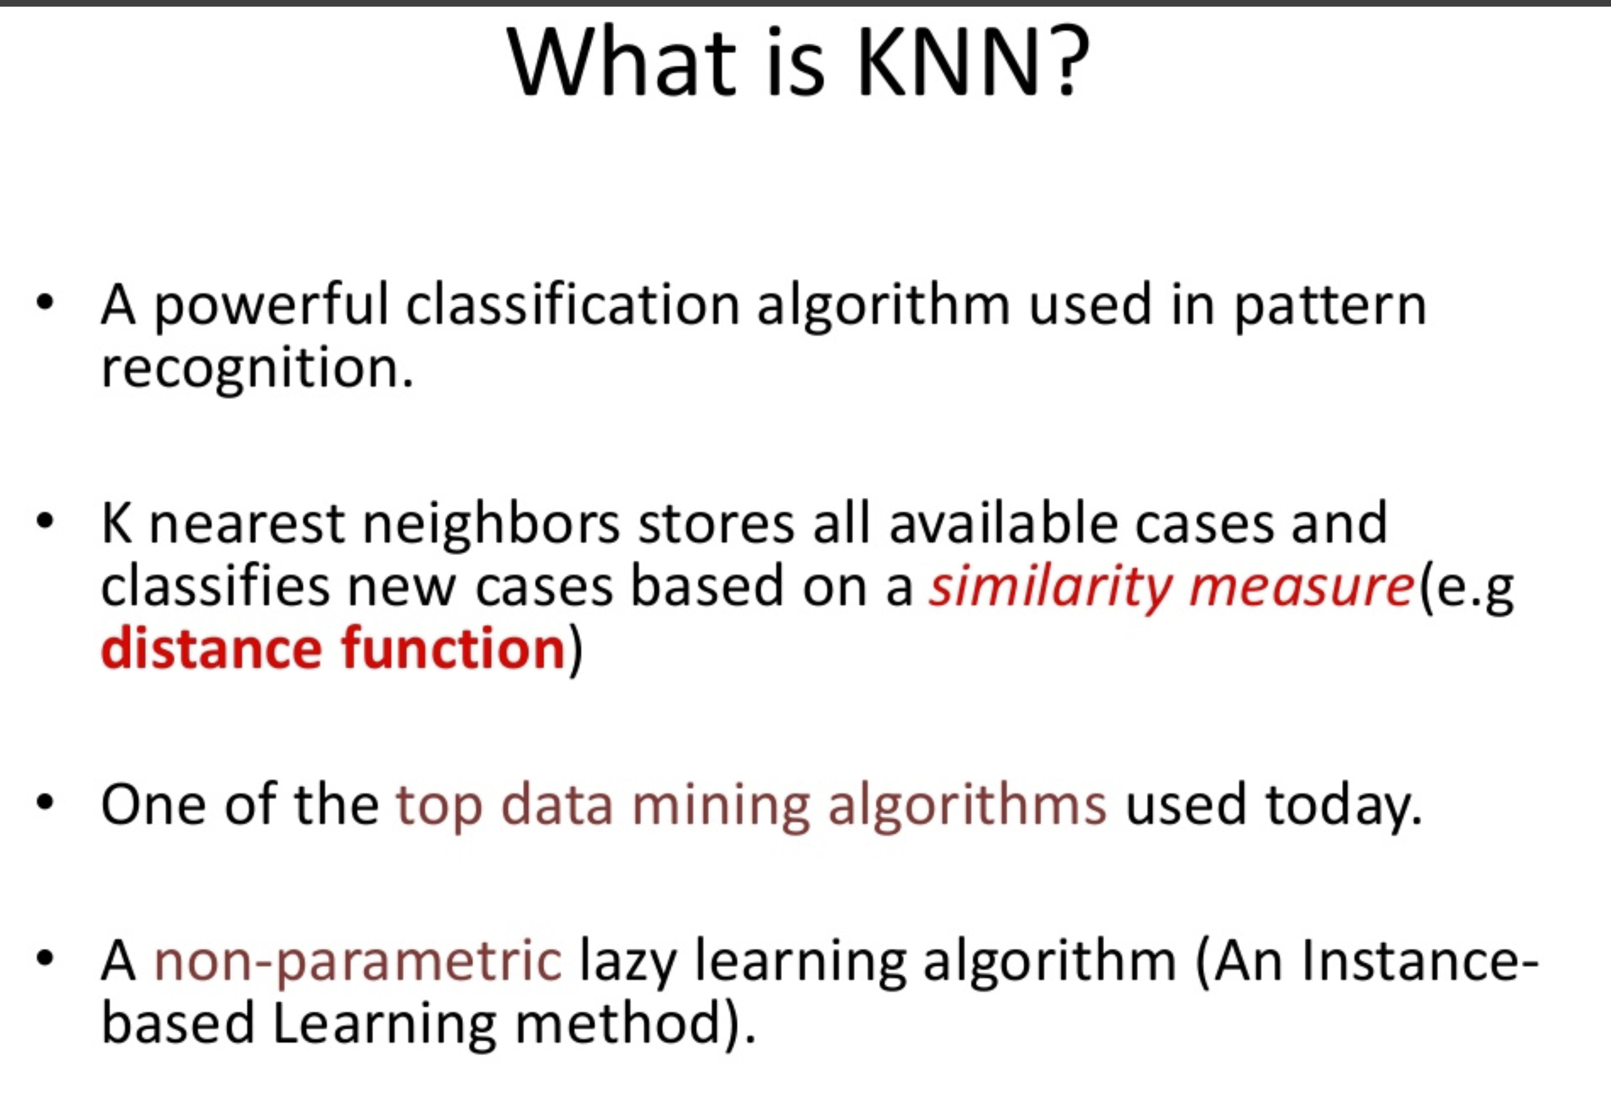
K Nearest Neighbors (KNN)

Slide 16
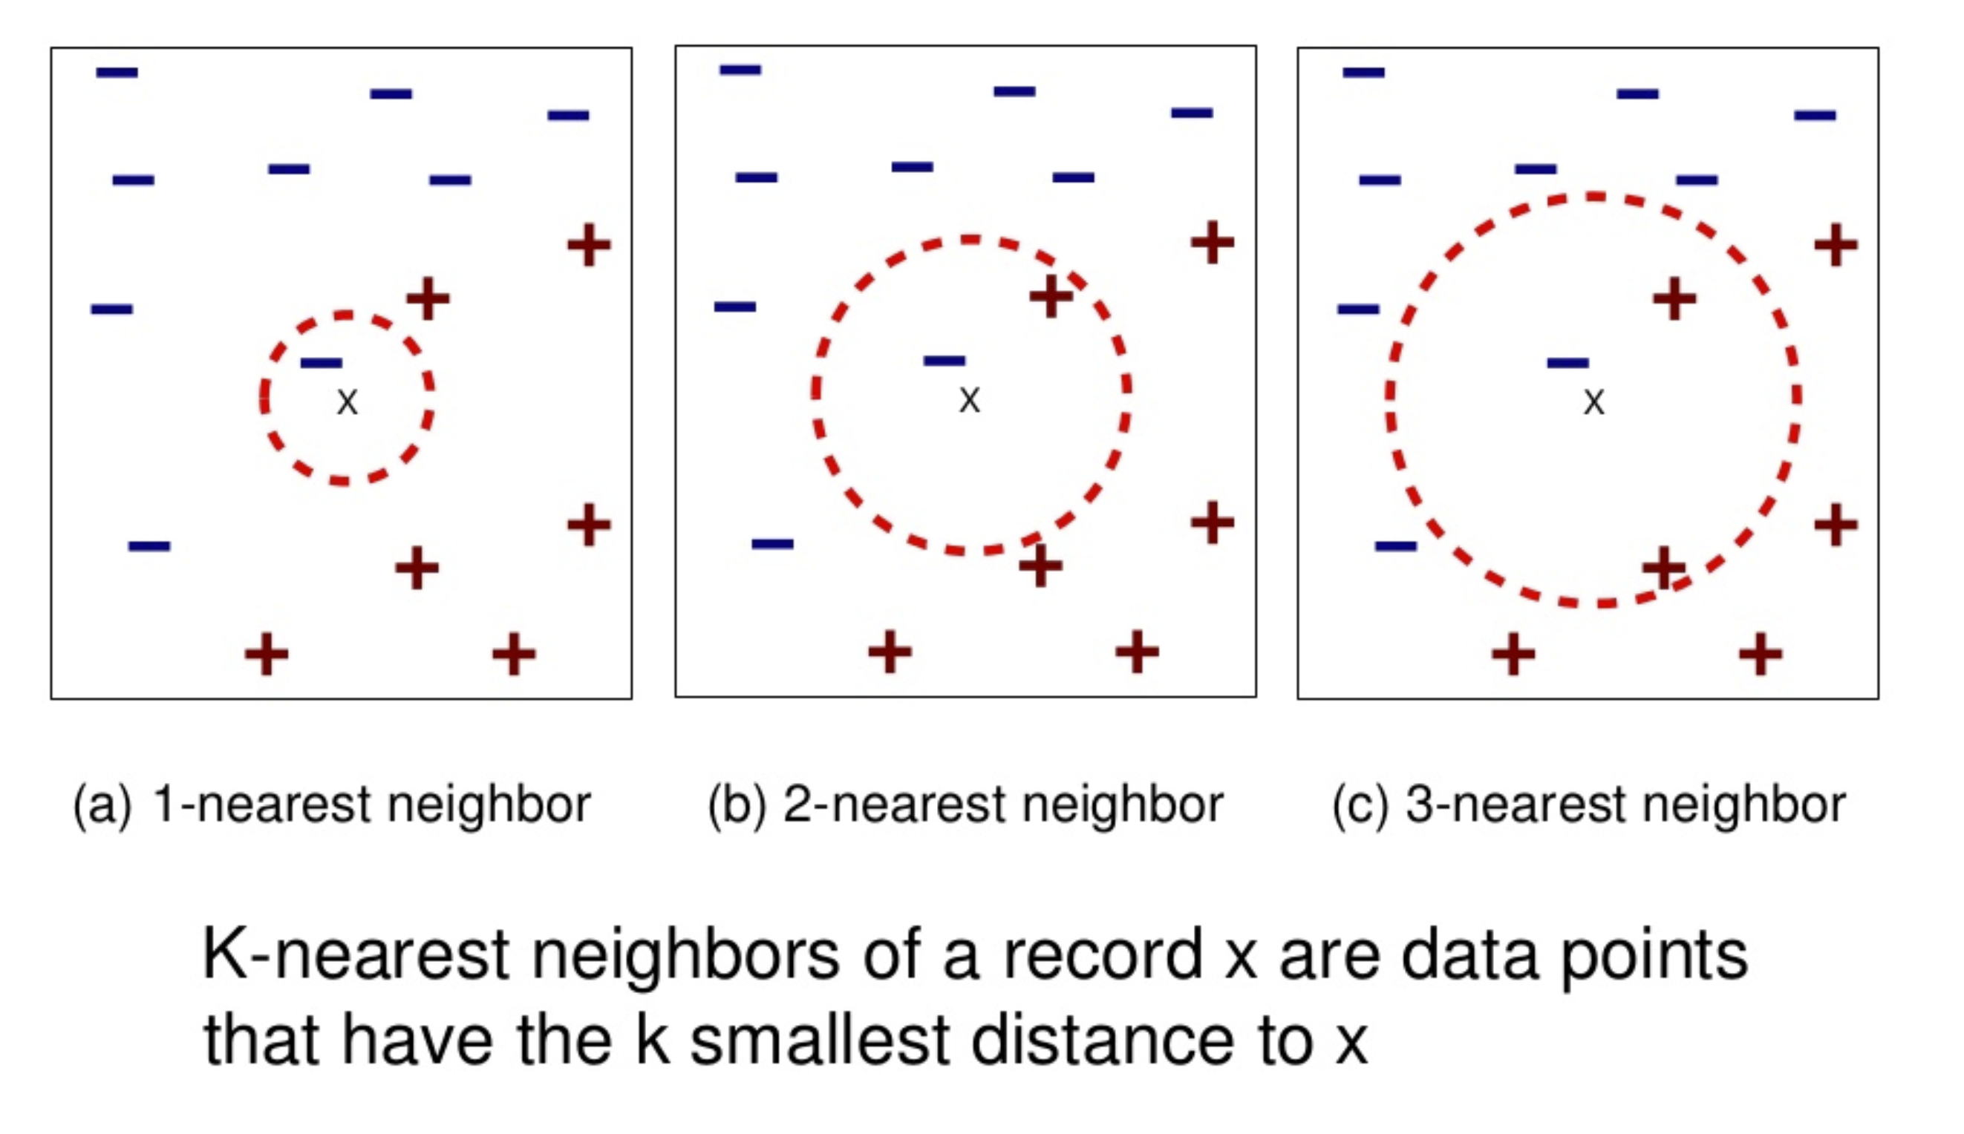
KNN Example

Slide 17
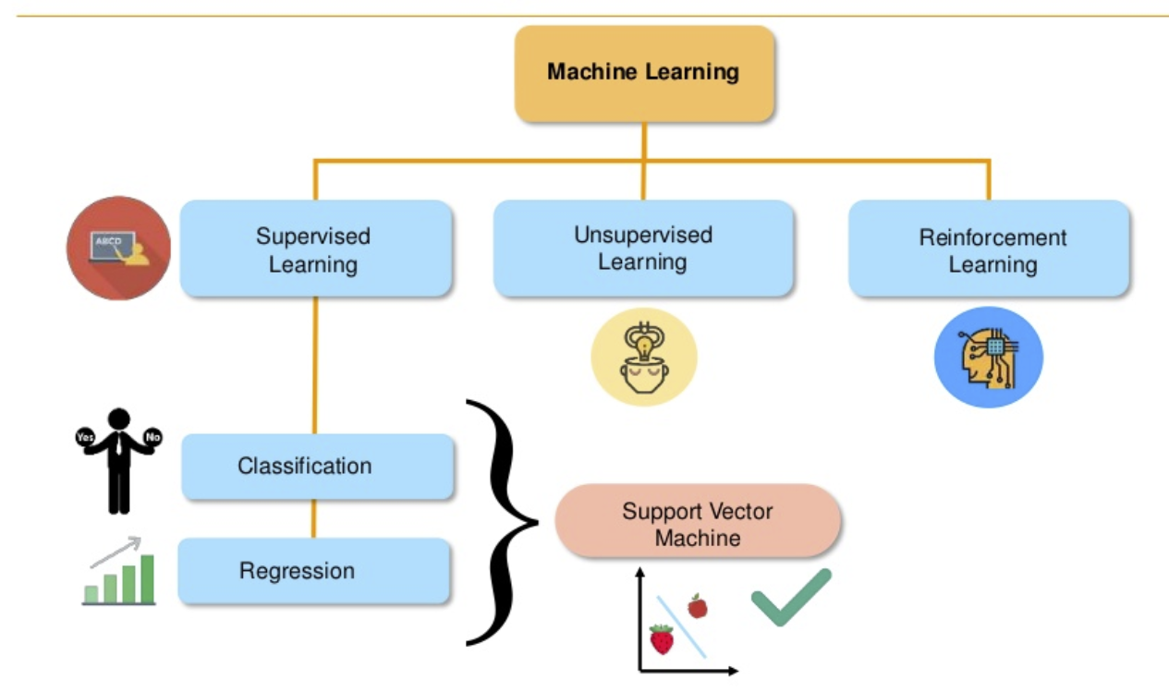
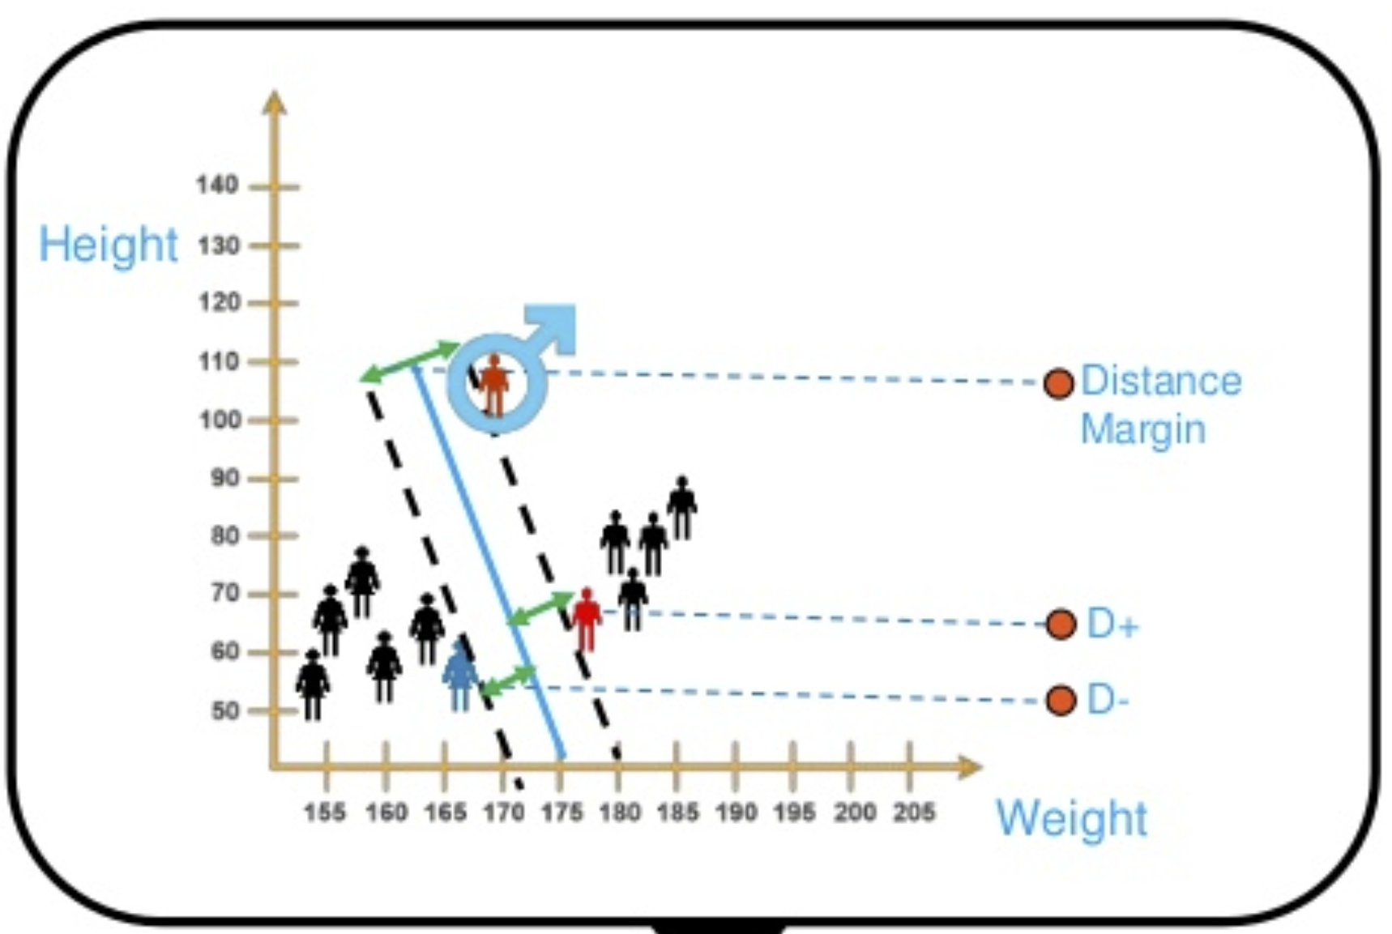
SVM Support Vector Machines
https://www.slideshare.net/Simplilearn/support-vector-machine-how-support-vector-machine-works-svm-in-machine-learning-simplilearn?qid=8e732d49-ee9b-4ce8-9046-6f06b4c04ef7&v=&b=&from_search=6

Slide 18
Branches of AI
Machine Learning
Supervised
Unsupervised
Linear, Logistic regression
K-means
Decision Trees
Sentiment Analysis
Support Vector Machine
AI
Convolutional Neural Networks (CNN)
Recurrent Neural Networks (RNN)
Long Short Term Memory Networks (LSTM)
Deep Learning
Image Recognition
Machine Vision
Machine Translation
Chat Bots
Sentiment Analysis
NL Generation
Vision
Natural Language Programming

